Slide 1
RDMA at Hyperscale: Experience and Future Directions
Wei Bai
Microsoft Research Redmond
APNet 2023, Hong Kong
Notes:
Hello everyone, I am very happy to be here to present collective work of Azure and MSR on RDMA networking

Slide 2
TL;DR
We use RDMA for storage traffic
RoCEv2 over commodity Ethernet/IP network
Enabled for speeds > 100gbps, over distances up to 100km
~ 70% Azure traffic (bytes and packets)
Made possible by many innovations
DCQCN
RDMA Estats
PFC watchdog
Carefully tuned libraries… and much more
Many opportunities ahead!

Slide 3
Azure storage overview

Slide 4
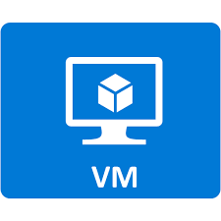

Disaggregated storage in Azure
Azure Compute
Azure Storage

Slide 5
Disaggregated storage in Azure
Backend
Frontend
Azure Compute
Azure Storage

Slide 6
Disaggregated storage in Azure
~70% of total network traffic
Backend
Frontend
Azure Compute
Azure Storage
Majority of network traffic generated by VMs is related to storage I/O

Slide 7
Use TCP or RDMA?
Application: “Write the block of data at local disk w, address x to remote disk y, address z”
CPU
CPU
Packetize
Stream
Post
Indicate
Interrupt
Copy
Application
TCPIP
TCPIP
Application
TCP: Waste of CPU, high latency due to CPU processing
Write local buffer at Address A to remote
buffer at Address B
Buffer B is filled
Application
Application
DMA
DMA
Memory
Memory
Buffer A
Buffer B
RDMA: NIC handles all transfers via DMA
Notes:
TCP vs RDMA :
TCP: Two hosts connected by network
TCP/IP stack runs on both the hosts
Data transfer involves CPU on both the sides to run the TCP/IP stack
RDMA: Two hosts connected by network
RDMA stack runs on NIC of the two hosts
Minimal involvement of CPU on both sides
Application posts RDMA Write request to the NIC without kernel involvement
NIC reads the buffer content and sends it over the network
RDMA Write message on the network contains the destination virtual address and memory key as well as data itself
NIC verifies the memory key and writes the data directly into the application buffer without CPU involvement
RDMA is like a formula 1 racing car, TCP is a family minivan

Slide 8
RDMA Benefits benefits
For Azure
Sell freed-up CPU cores in compute
For Customers
Buy cheaper servers in storage
Lower IO latency and jitter
Core savings

Slide 9
Two main RDMA networking techniques
InfiniBand (IB)
The original RDMA technology
Custom stack (L1-L7), incompatible with Ethernet/IP
Hence expensive
Scaling problems
RoCE (v2)
RDMA over converged Ethernet
Compatible with Ethernet/IP
Hence cheap
Can scale to DC and beyond
Our choice
There is also iWarp
Notes:
\

Slide 10

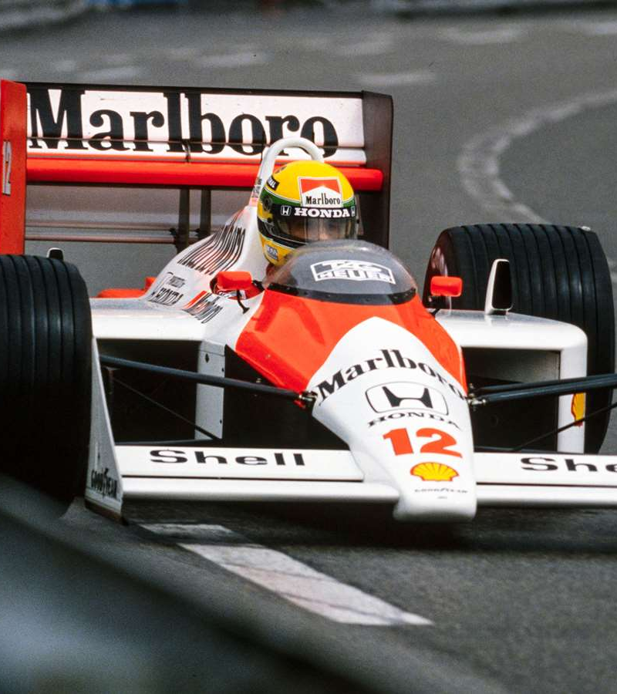
TCP
RDMA

Slide 11
Problems …
Tailor storage code for RDMA? (not socket programming!)
How do we monitor performance? (not TCP!)
What network configuration do we need?
Congestion control?
And many others ….

Slide 12
Solutions …
Custom libraries: sU-RDMA and sK-RDMA
Host monitoring: RDMA Estats
SONiC, PFC WD, careful buffer tuning …
DCQCN
And much more

Slide 13
Tailor storage code for RDMA?
Two libraries: user-space, and kernel-space (extends SMB-direct)
RDMA operations optimizations, plus TCP fallback if needed

Slide 14
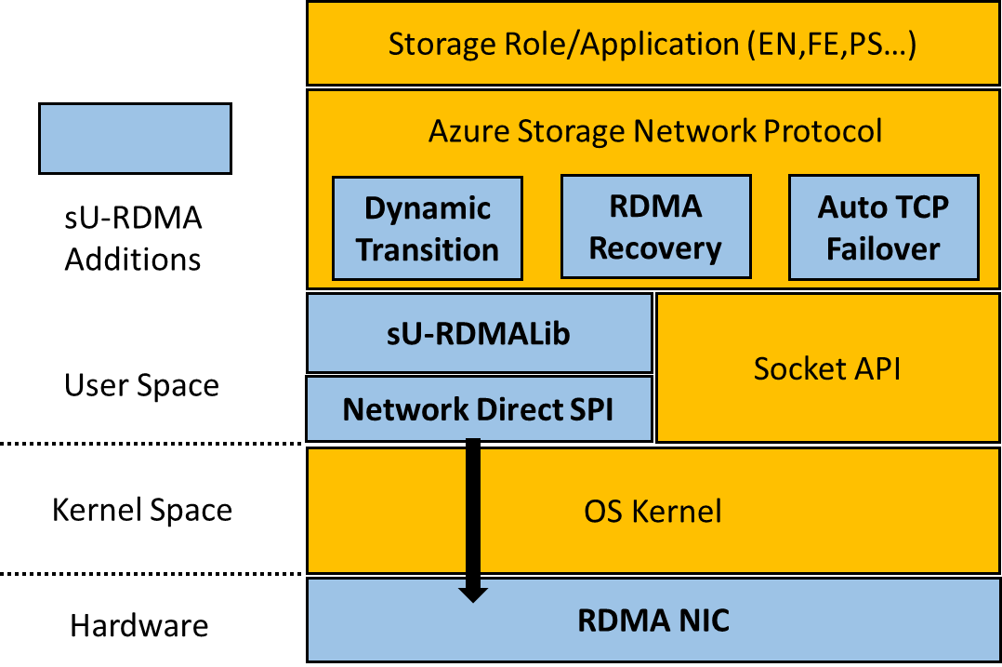
sU-RDMA* for storage backend
Translate Socket APIs to RDMA verbs
Three transfer modes based on message sizes
TCP and RDMA transitions
If RDMA fails, switch to TCP
After some time try reverting back to RDMA.
Chunking: static window
*sU-RDMA = storage user space RDMA

Slide 15
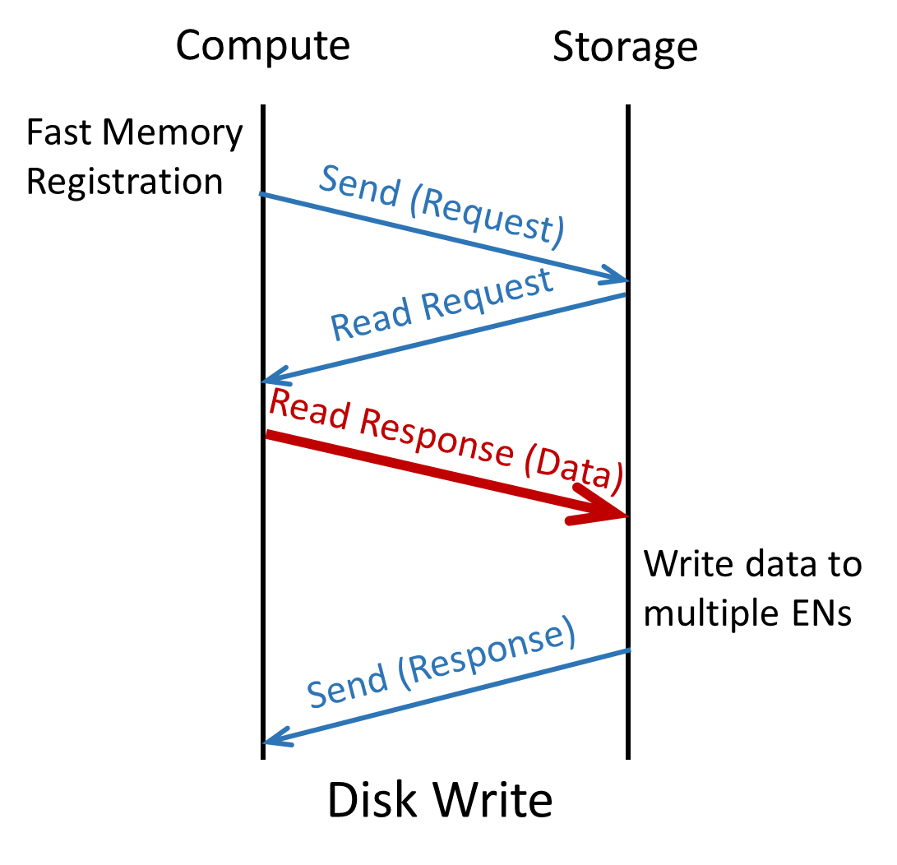
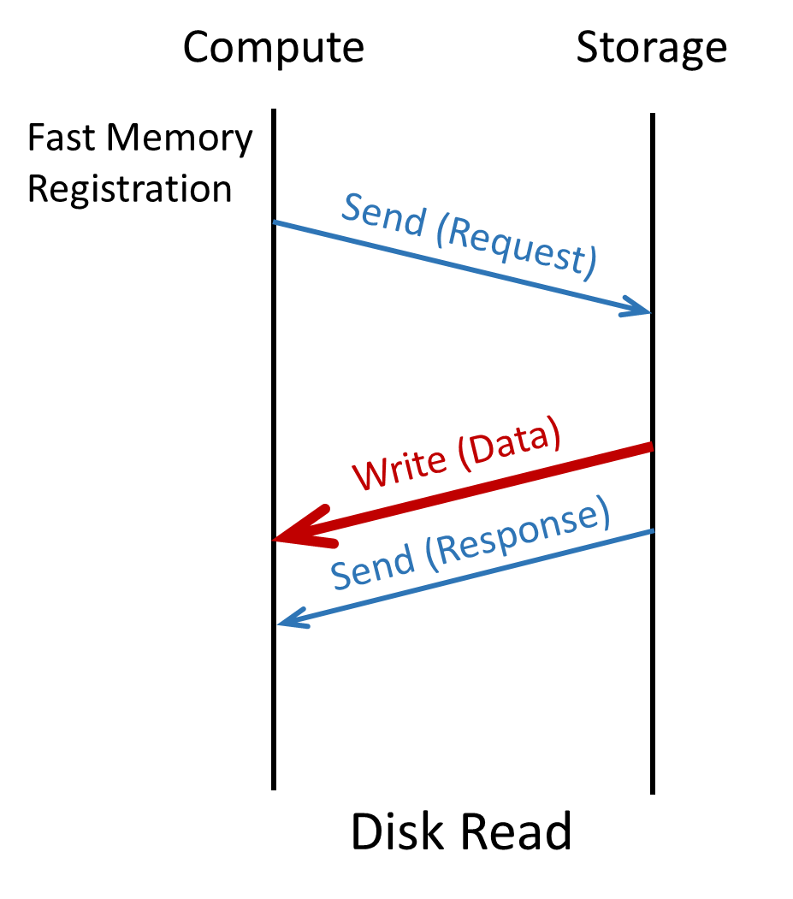
sK-RDMA* for storage frontend
Extend SMB Direct. Run RDMA in kernel space.
Read from any EN
*sK-RDMA = storage kernel space RDMA

Slide 16
How do we monitor RDMA traffic?
On host: RDMA Estats and NIC counters
On routers: standard router telemetry (PFCs sent and received, per-queue traffic and drop counters, special PFC WD summary)

Slide 17
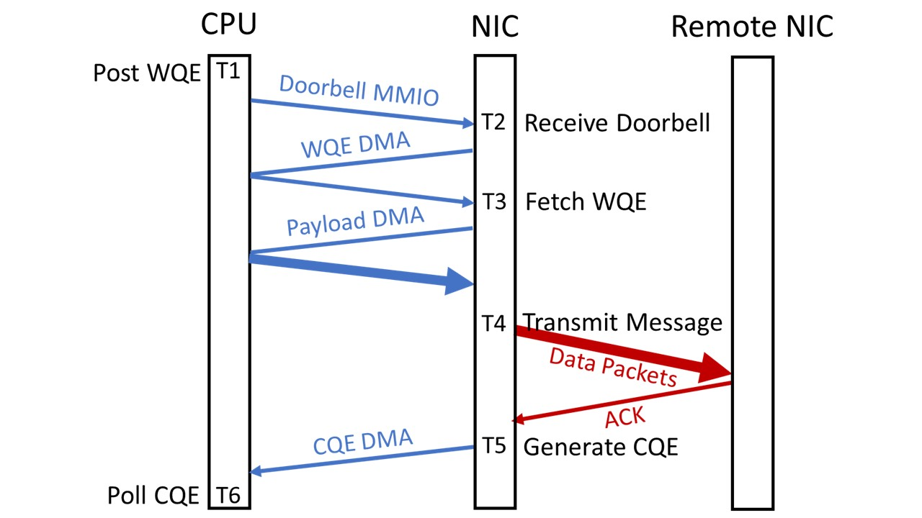
RDMA Estats
Akin to TCP Estats
Provides fine-grained latency breakdown for each RDMA operation
Data aggregated over 1 minute
T6 - T1: client latency
T5 - T1: hardware latency
Must sync CPU and NIC clocks!

Slide 18
What special network configuration do we need and why?
Need lossless Ethernet
Sample config with SONiC

Slide 19
RoCEv2 packet format
Ethernet
IP
UDP
InfiniBand L4
Payload
Needs a lossless* fabric
for fast start, no retransmission…
Lossless Ethernet
Priority-based Flow Control (PFC)
IEEE 802.1Qbb
*Lossless: no congestion packet drop
Notes:
Since we need a lossless fabric, and we want to run this on Ethernet networks, we need a lossless Ethernet.
The protocol to realize this, is called …

Slide 20
Why lossless?
Fast start
Reduces latency in common cases
No retransmission due to congestion drop
Reduce tail latency
Simplifies transport protocol
ACK consolidation
Improve efficiency
Older NICs were inefficient at retransmission

Slide 21
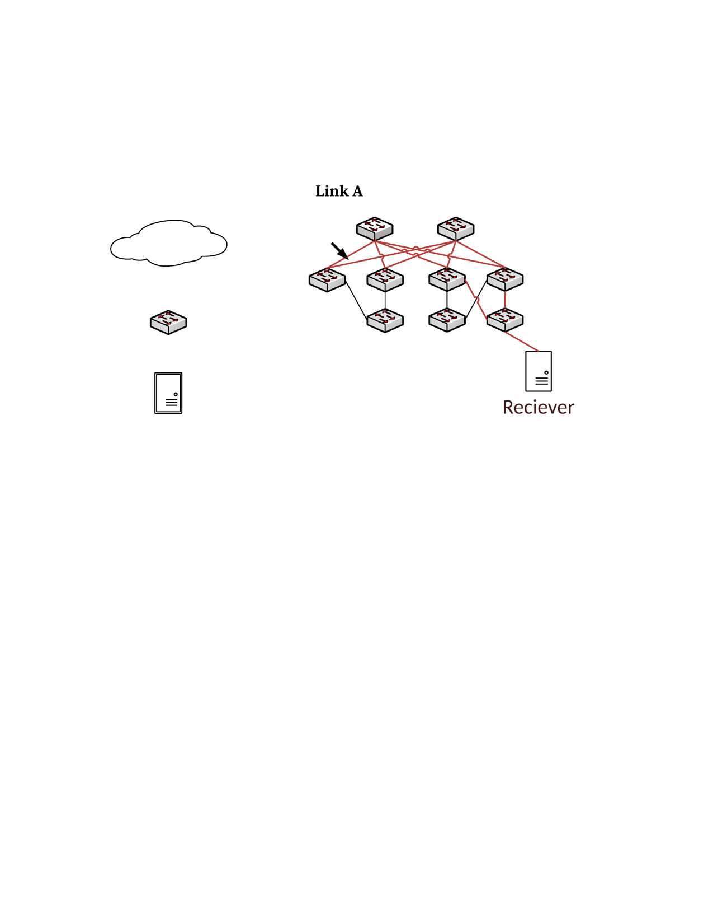
Priority-based Flow Control (PFC)
Congestion
PAUSE
PFC PAUSE threshold: 3
Pause upstream neighbor when queue over XOFF limit
Ensures no congestion drop
Notes:
The idea of PFC is hop-by-hop flow control. The switches pause ingress port to limit buffer usage. For example, the switches have a PFC threshold of 3 packets.
As packets come in, and due to congestion, the queue builds up. Once the queue length reaches the threshold, the switch pauses the previous hop for the blue priority. The previous hop will stop sending the blue packets. So the buffer will never be full and never drop packets.
At the same time, other priority can still go through.
Although PFC avoids packet drops, but it also causes troubles in large-scale deployments.

Slide 22
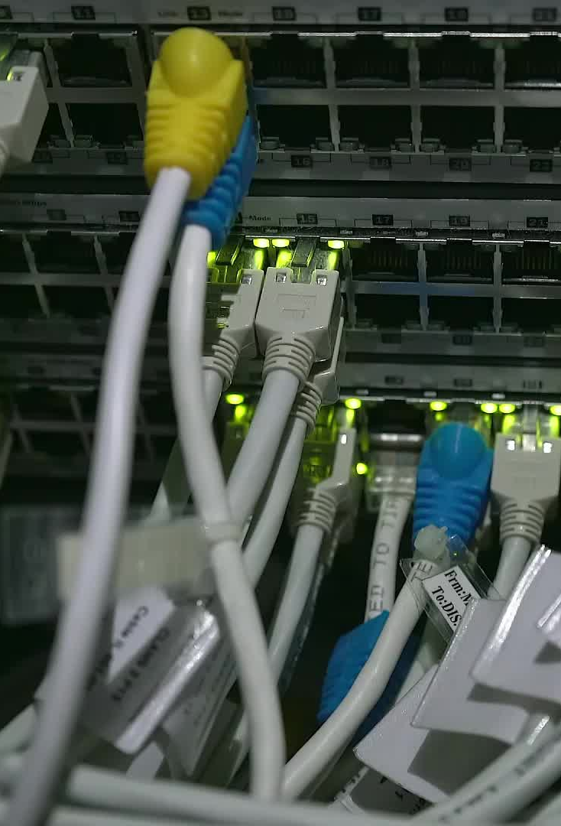
PFC and associated buffer configuration is non-trivial
Headroom – which depends on cable length
Joint ECN-PFC config – ECN must trigger before PFC (more on this later)
Configure PFC watchdog to guard against hardware faults
.. And all this on heterogenous, multi-generation routers

Slide 23





SONiC: Software for Open Networking in the Cloud
New
More apps
SNMP
BGP
DHCP
BGP
IPv6
New
Database
Platform
TeamD
LLDP
A Containerized Cross-platform Switch OS
SWSS
Utility
RedisDB
SYNCD
Multiple ASIC Vendors

Slide 24



SONiC: Software for Open Networking in the Cloud
Cloud Provider
using SONiC
Open Software
+
Standardized Hardware Interfaces
New
More apps
SNMP
BGP
DHCP
BGP
IPv6
New
Database
Platform
TeamD
LLDP
A Containerized Cross-platform Switch OS
SWSS
Utility
RedisDB
SYNCD
ASIC Vendor
Notes:
SONiC stands for ..
SAI provides unified interfaces and behavior models for the switch. ASIC vendors provide implementations of SAI. SAI enables switch OS to use a universal language to talk to different vendors.
SONiC is built on the top of SAI.

Slide 25
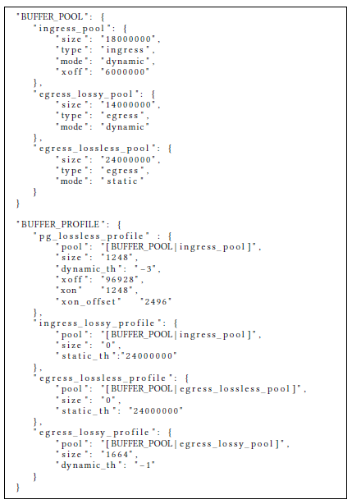
RDMA features in SONiC
ECN
Shared buffer
PFC
PFC headroom pool
PFC watchdog
Various counters
A SONiC Buffer Template Example
If a queue has been in paused state for very long time, drop all its packets
Notes:
When we design SONiC, we take RDMA required features into consideration from the day one.
But given these features, how to test them? How to ensure they work as expected?

Slide 26
Congestion control in heterogenous environment
DCQCN

Slide 27
Why do we need congestion control?
PFC operates on a per-port/priority basis, not per-flow.
It can spread congestion, is unfair, and can lead to deadlocks!
Zhu et al. [SIGCOMM’15], Guo et al. [SIGCOMM’16], Hu et al. [HotNets’17]

Slide 28
Solution
Minimize PFC generation using per-flow E2E congestion control
BUT keep PFC to allow fast start and lower tail latency
In other words, use PFC as a last-resort
28
Notes:
One naïve solution is to assign each flow a separate priority. But this is not scalable due to hardware limit.
Our solution is to keep PFC, but add a per-flow E2E congestion control algorithm.
Per flow congestion control reduces the switch buffer usage, thus reduce PFC generations.
But we don’t want to go back to the heavyweight TCP! We want keep PFC, keep the benefits of lossless network, like no retransmissions, fast start, …
The main idea is to use PFC only in emergent cases, not in the common state. Per-flow congestion control optimizes the common cases

Slide 29
DCQCN
Marked Packets
Sender
Congestion
Receiver
Congestion Notifications
Sender lowers rate when notified of congestion
Rate based, RTT-oblivious congestion control
ECN as congestion signal (better stability than delay)
Congestion control for large-scale RDMA deployments, SIGCOMM 2015

Slide 30
Network architecture of an Azure region
Regional Hub
Data Center
T2
Cluster
T1
T0
Server
Notes:
This figure gives the topology of an Azure region. Green ones are servers. Then there are four tiers of switches, T0, T1, T2 and RH.

Slide 31
Azure needs intra-region RDMA
RDMA
Regional Hub
T2
T1
T0
Server
Compute
Storage
Compute
Storage
Notes:
In Azure, a compute VM can fetch the blob from any storage cluster inside the region. Therefore, RDMA traffic may cross different datacenters.

Slide 32
Large and variable latency end-to-end
Intra-rack RTT: 2us
Intra-DC RTT: 10s of us
Intra-region RTT: 2ms
Regional Hub
Up to 100km
500us delay
T2
300m
T1
40m
T0
5m
Server
Notes:
This means our RDMA traffic will experience a large RTT variation due to long haul cables between T2 and RH.

Slide 33
Heterogenous NICs
Different types of NICs have different transport (e.g., DCQCN) implementations
Regional Hub
T2
T1
T0
Gen1
Gen1
Gen2
Gen3
Server
Notes:
We also need to handle heterogenous NIC hardware.
[click]
In Azure, different clusters use different hardware. Old clusters use CX3 while the new ones use CX4 and CX5. And they have different DCQCN implementations.

Slide 34
DCQCN in production
Different DCQCN implementations on NIC Gen1/2/3
Gen1 has DCQCN implemented in firmware (slow) and uses a different congestion notification mechanism.
Solution: modify firmware of Gen2 and Gen3 to make them behave like Gen1
Careful DCQCN tuning for a wide range of RTTs
Interesting observation: DCQCN has near-perfect RTT fairness
Careful buffer tuning for various switches
Ensure that ECN kicks in before PFC

Slide 35
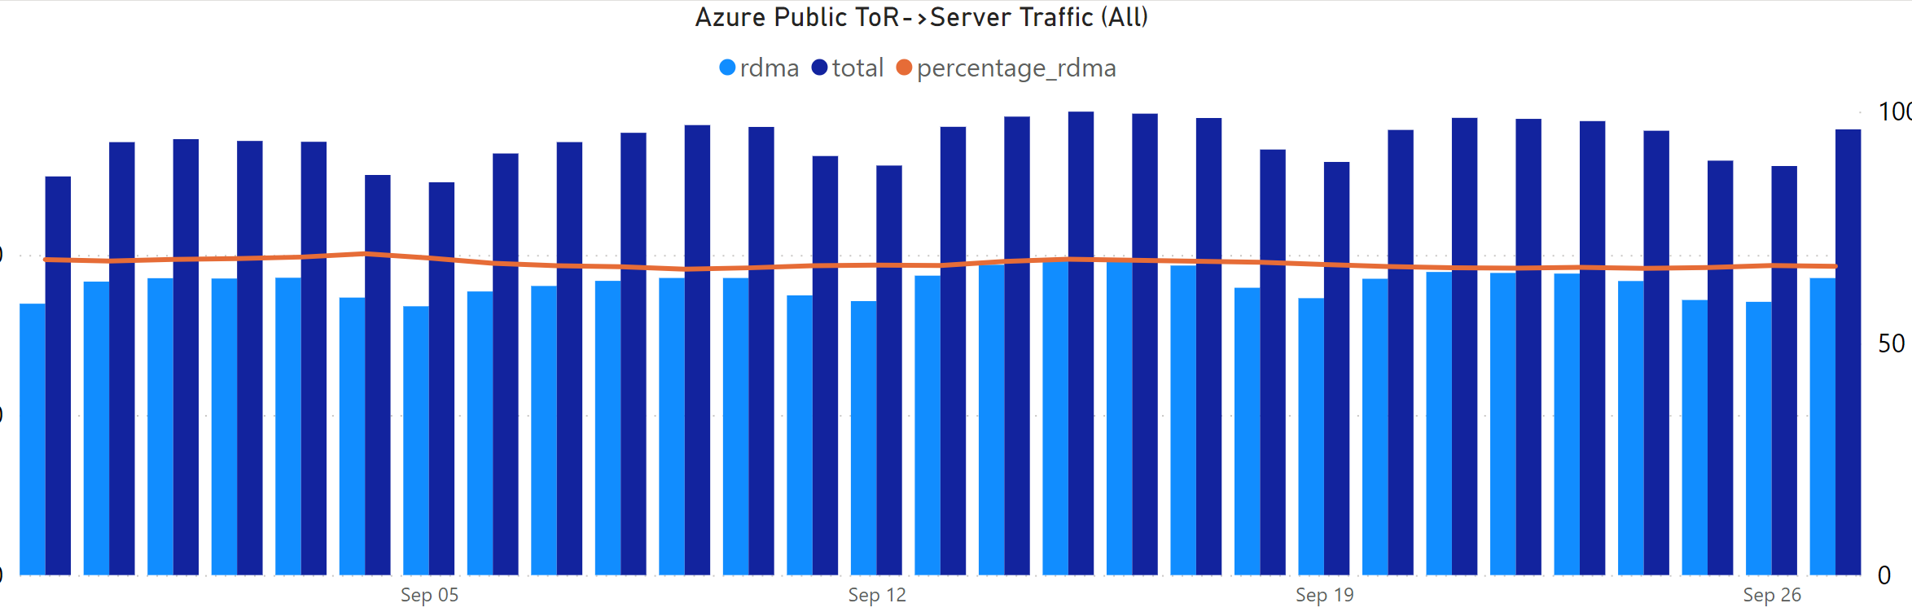
100x100 100 Gbps over 100 km
O(10¹⁸) bytes / day, O(10⁹) IOs / day
~70% of bytes. TCP distant second.
Significant perf improvements and COGS savings
Possibly largest RDMA deployment in the world

Slide 36
Problems fixed, lessons and open problems
Many new research directions

Slide 37
Problems discovered and fixed
Congestion leaking
Flows sent by the NIC always have near identical sending rates regardless of their congestion degrees
PFC and MACsec
Different switches have no agreement on whether PFC frames sent should be encrypted or what to do with arriving encrypted PFC frames
Slow receiver due to loopback RDMA traffic
Loopback RDMA traffic and inter-host RDMA traffic cause host congestion
Fast Memory Registration (FMR) hidden fence
The NIC processes the FMR request only after the completions of previously posted requests

Slide 38
Lessons and open problems
Failovers are very expensive for RDMA
Host network and physical network should be converged
Switch buffer is increasingly important and needs more innovations
Cloud needs unified behavior models and interfaces for network devices
Testing new network devices is critical and challenging

Slide 39
Lessons and open problems
Failovers are very expensive for RDMA
Host network and physical network should be converged
Switch buffer is increasingly important and needs more innovations
Cloud needs unified behavior models and interfaces for network devices
Testing new network devices is critical and challenging

Slide 40
Lessons and open problems
Failovers are very expensive for RDMA
Host network and physical network should be converged
Switch buffer is increasingly important and needs more innovations
Cloud needs unified behavior models and interfaces for network devices
Testing new network devices is critical and challenging

Slide 41
Lessons and open problems
Failovers are very expensive for RDMA
Host network and physical network should be converged
Switch buffer is increasingly important and needs more innovations
Cloud needs unified behavior models and interfaces for network devices
Testing new network devices is critical and challenging

Slide 42
Lessons and open problems
Failovers are very expensive for RDMA
Host network and physical network should be converged
Switch buffer is increasingly important and needs more innovations
Cloud needs unified behavior models and interfaces for network devices
Testing new network devices is critical and challenging

Slide 43
Lessons and open problems
Failovers are very expensive for RDMA
Host network and physical network should be converged
Switch buffer is increasingly important and needs more innovations
Cloud needs unified behavior models and interfaces for network devices
Testing new network devices is critical and challenging

Slide 44
Husky
Understanding RDMA Microarchitecture Resources for Performance Isolation
Credit of slides: Xinhao Kong

Slide 45


RDMA microarchitecture resource contention
Tenants
RX Pipelines
（processing unit)
PCIe
Fabric
Network fabric
PCIe
Fabric
NIC Cache
(Translation)
NIC Cache
(Connection)
TX Pipelines
（processing unit)
RDMA NIC

Slide 46
SEND/RECV error handling exhausts RX pipelines
RX Pipelines
（processing unit)
PCIe
Fabric
Network fabric
NIC Cache
(Translation)
NIC Cache
(Connection)
TX Pipelines
（processing unit)
RDMA NIC
Notes:
Another finding is about SEND/RECV error handling exhaust RX pipelines.

Slide 47
SEND/RECV needs prepared receive requests
Post RECV requests
RX Pipelines
（processing unit)
PCIe
Fabric
Network fabric
NIC Cache
(Translation)
NIC Cache
(Connection)
TX Pipelines
（processing unit)
RDMA NIC
Notes:
Before we discuss the error concretely, let’s review how SEND/RECV works. To receive the payload, in RDMA, the receiver needs to post some receive requests.

Slide 48
SEND/RECV needs prepared receive requests
incoming SEND request
RX Pipelines
（processing unit)
RECV request
PCIe
Fabric
Network fabric
NIC Cache
(Translation)
NIC Cache
(Connection)
TX Pipelines
（processing unit)
RDMA NIC
Notes:
When incoming SEND requests arrive, the NIC will consume the posted RECV requests to process the incoming requests. As this figure shows, everything goes correctly.

Slide 49

Receive-Not-Ready (RNR) consumes RX pipelines
RX pipelines handle such errors and discard requests
SEND request
RX Pipelines
（processing unit)
PCIe
Fabric
NIC Cache
(Translation)
NIC Cache
(Connection)
TX Pipelines
（processing unit)
RDMA NIC
Notes:
However, if the receiver does not post any receive request at all. An error, called receive-not-ready will be triggered. The RX pipelines will handle such errors and discard the incoming SEND requests.

Slide 50
RNR causes severe RX pipelines contention
RX pipelines handle such errors and discard requests
SEND request
RX Pipelines
（processing unit)
PCIe
Fabric
NIC Cache
(Translation)
NIC Cache
(Connection)
ANY workload
TX Pipelines
（processing unit)
 | Victim Bandwidth | Attacker Bandwidth
w/o RNR error | 97.07 Gbps | \
w/ RNR error | 0.018 Gbps | 0 Gbps
RDMA NIC
Notes:
What we observe is that - if at the same time, there is another tenant have incoming traffics, say, this blue tenant. This tenant’s traffics will be all blocked, no matter what types of workload it is. For example, if we let the victim to be a simple write traffic, its performance can drop from 97 Gbps to almost 0 after the RNR error is triggered by the attacker.

Slide 51
Lumina
Understanding the Micro-Behaviors of Hardware Offloaded Network Stacks
Credit of slides: Zhuolong Yu

Slide 52
Lumina: an in-network solution
Initiator
Target
Inject event (e.g., packet drop, ECN marking, packet corruption)
Forward traffic
Application
Application
TCP/IP Stack
TCP/IP Stack
NIC Driver
NIC Driver
RDMA NIC
Programmable Switch
RDMA NIC
Mirror
Offline analyzation
Notes:
To address this challenges, we propose Lumina, which takes an in-network solution
(click) Lumina uses a programmable switch as the middlebox to inject events to the traffic. And of course, it will also forward traffic between devices.
Since the middlebox may not have enough resource and flexibility to realize complex measurement,
(click) we mirror all the packets from the middlebox to dedicated servers for offline analyzation.

Slide 53
Experiment setting
RDMA Verb: WRITE and READ
Message size = 100KB, MTU=1KB
For each message, drop i-th packet in each message
RNICs under test: NVIDIA CX4 Lx, CX5, CX6 Dx, and Intel E810
Drop the i-th packet
Requester
Injector
Responder
Retransmission latency
NACK generation latency
NACK reaction latency

Slide 54
Retransmission latency
READ
WRITE
Significant improvement from NVIDIA CX4 Lx to CX5 and CX6 Dx
Intel E810 cannot efficiently recover lost READ packets

Slide 55
Project contributors
“Empowering Azure Storage with RDMA” NSDI '23 (Operational Systems Track)
Wei Bai, Shanim Sainul Abdeen, Ankit Agrawal, Krishan Kumar Attre, Paramvir Bahl, Ameya Bhagat, Gowri Bhaskara, Tanya Brokhman, Lei Cao, Ahmad Cheema, Rebecca Chow, Jeff Cohen, Mahmoud Elhaddad, Vivek Ette, Igal Figlin, Daniel Firestone, Mathew George, Ilya German, Lakhmeet Ghai, Eric Green, Albert Greenberg, Manish Gupta, Randy Haagens, Matthew Hendel, Ridwan Howlader, Neetha John, Julia Johnstone, Tom Jolly, Greg Kramer, David Kruse, Ankit Kumar, Erica Lan, Ivan Lee, Avi Levy, Marina Lipshteyn, Xin Liu, Chen Liu, Guohan Lu, Yuemin Lu, Xiakun Lu, Vadim Makhervaks, Ulad Malashanka, David A. Maltz, Ilias Marinos, Rohan Mehta, Sharda Murthi, Anup Namdhari, Aaron Ogus, Jitendra Padhye, Madhav Pandya, Douglas Phillips, Adrian Power, Suraj Puri, Shachar Raindel, Jordan Rhee, Anthony Russo, Maneesh Sah, Ali Sheriff, Chris Sparacino, Ashutosh Srivastava, Weixiang Sun, Nick Swanson, Fuhou Tian, Lukasz Tomczyk, Vamsi Vadlamuri, Alec Wolman, Ying Xie, Joyce Yom, Lihua Yuan, Yanzhao Zhang, Brian Zill, and many others
“Understanding RDMA Microarchitecture Resources for Performance Isolation” NSDI '23
Xinhao Kong, Jingrong Chen, Wei Bai, Yechen Xu, Mahmoud Elhaddad, Shachar Raindel, Jitendra Padhye, Alvin R. Lebeck, Danyang Zhuo
“Understanding the Micro-Behaviors of Hardware Offloaded Network Stacks with Lumina” SIGCOMM '23
Zhuolong Yu, Bowen Su, Wei Bai, Shachar Raindel, Vladimir Braverman, Xin Jin
Technical support from Arista Networks, Broadcom, Cisco, Dell, Intel, Keysight, NVIDIA

Slide 56
Thank You!

